Slide 1
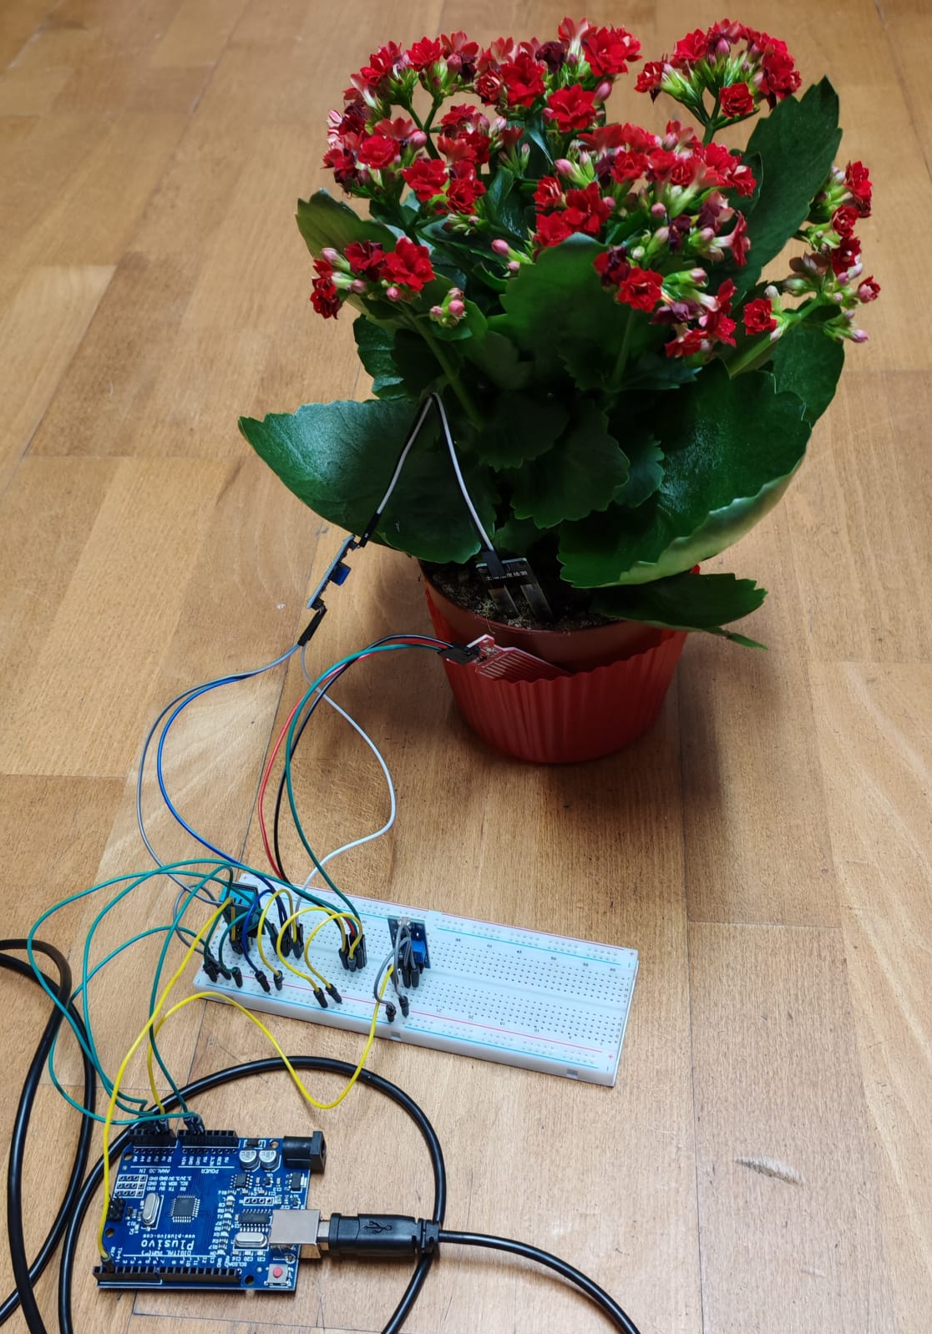
Talking Plant Smart Plant Monitoring System
Moruțan Maria
Ghiță Emma
Oneț Răzvan
Mitraşca Anamaria

Slide 2

Introduction
01.
02.
03.
Talking Plant is the plant that communicates its needs: a smart plant monitoring system that provides efficient care for plants
It helps with water saving, reducing waste and ensuring optimal conditions for plants
It monitors soil moisture, water level, light intensity, temperature and humidity

Slide 3
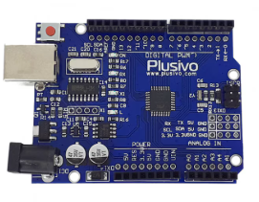
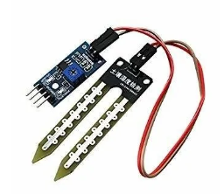
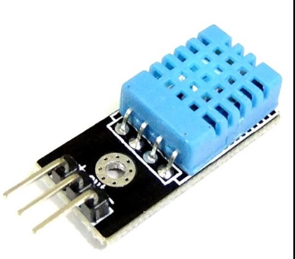
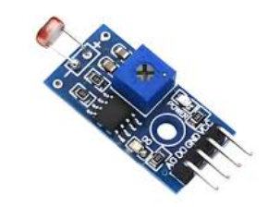
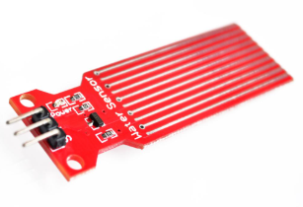
Components used
Arduino Board
Soil Moisture Sensor
Temperature and Humidity Sensor(DHT11)
Water Level Sensor
Light Sensor

Slide 4

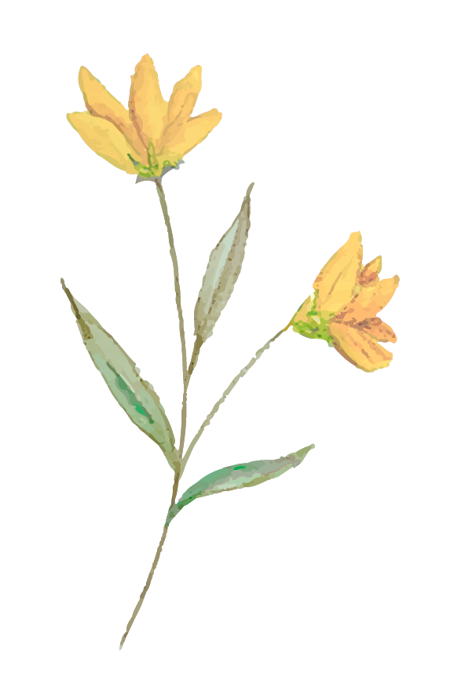
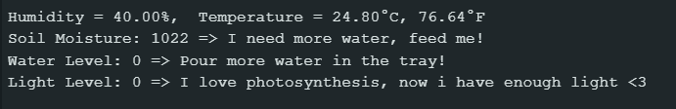


Functioning
01.
02.
03.
The four sensors collect data periodically
Data gets then processed by the Arduino board
The Arduino IDE program analyses the provided data and outputs the results based on the imposed thresholds

